Slide 1
Transportation Network Analysis Often Useful in Applications far from Transportation! Richard C. Larson (with Prof. Amedeo Odoni) 1.203J, 15.073J, IDS.700 November 20, 2017

Slide 2
Outline
Background and Definitions
Shortest path
Minimum spanning tree
Introduction to Travelling Salesman Problem and Chinese Postman Problem

Slide 3
Recall Continuum of Chapter 3
Then we add discrete streets, adding at most 1/3 of a block length in mean travel distance
What about shifting to a directed network, i.e., alternating one-way streets?
With transportation networks, we discretize geography

Slide 4
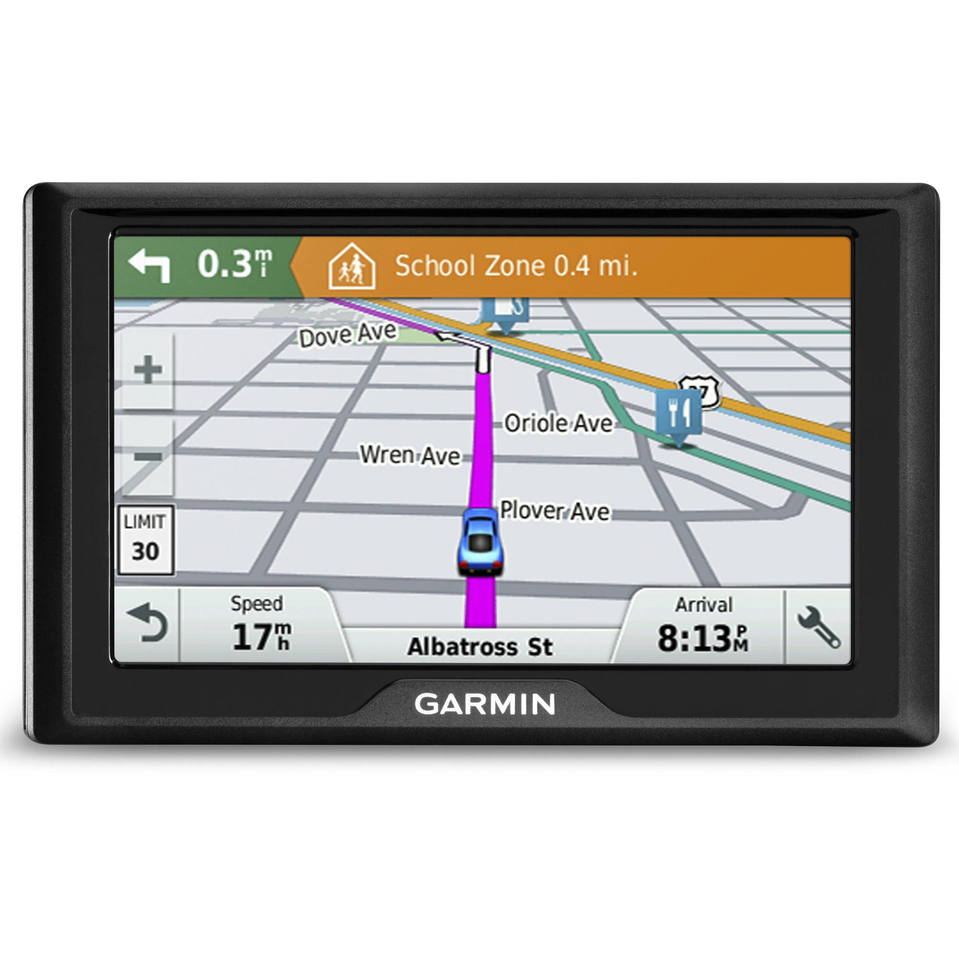
GPS Dashboard Maps

Slide 5

GPS Maps

Slide 6
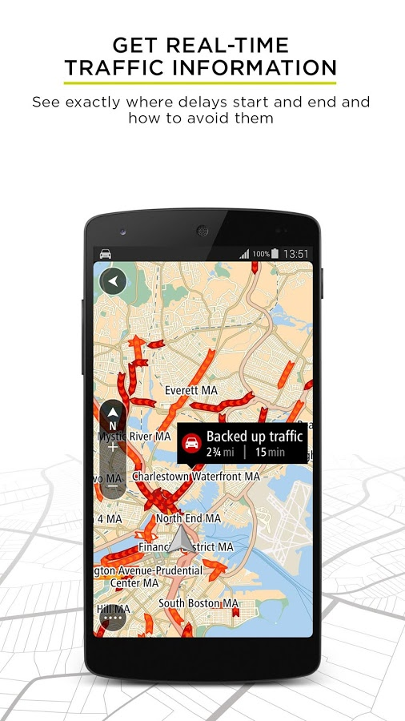
GPS Maps

Slide 7
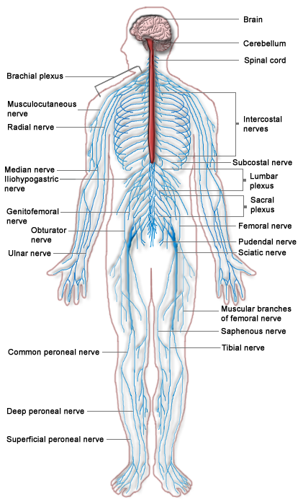
Central Nervous System

Slide 8

Social Networks

Slide 9
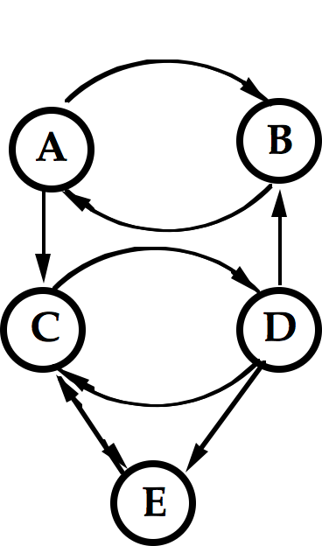
Illustrative Network

Slide 10
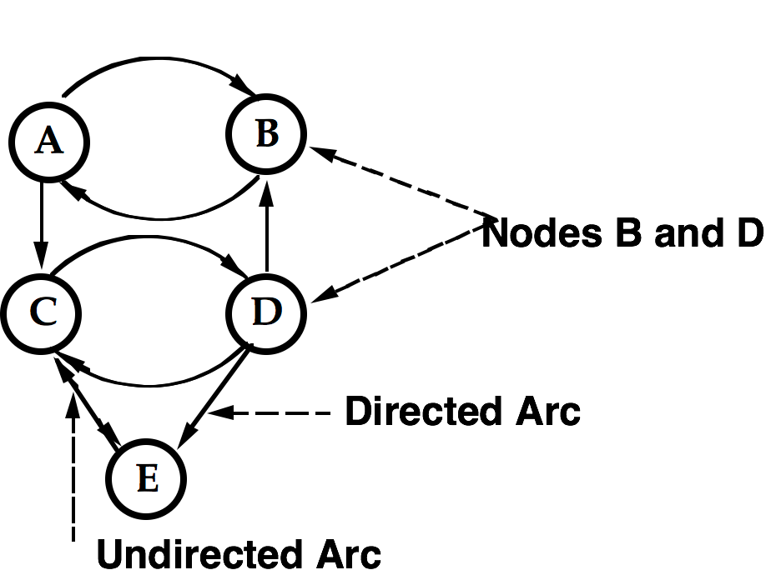
Network with Terminology

Slide 11
Examples of Nodes & Arcs
Nodes
Street intersections
Towns
Cities
Electrical junctions
Project milestones
People on Facebook
Arcs
Street segments
Country roads
Airplane travel time
Circuit components
Project tasks
Links to Friends on Facebook

Slide 12
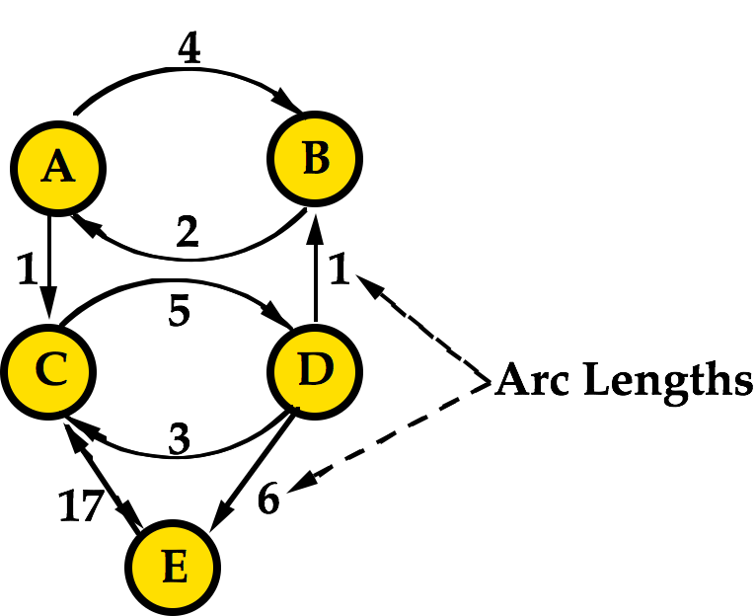
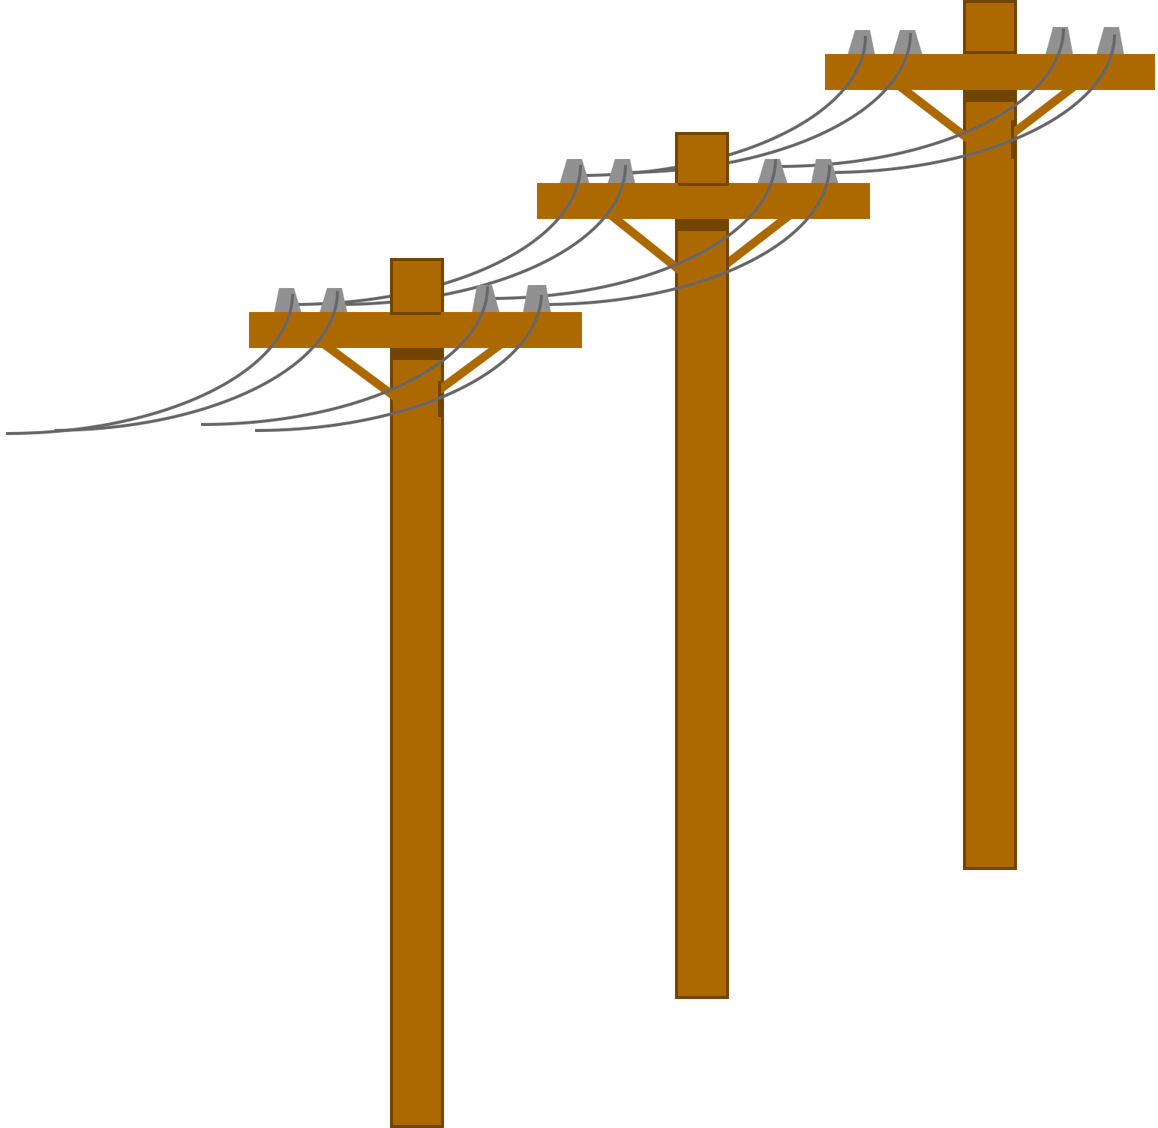
Arcs Can Have “Lengths”

Slide 13
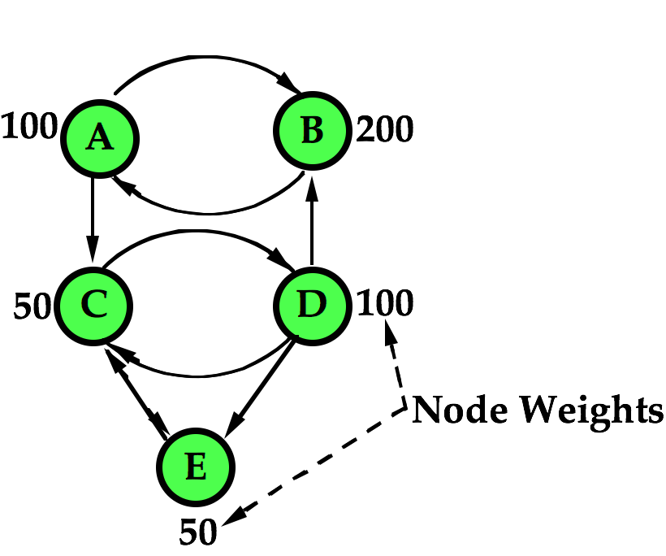
Nodes Can Have “Weights”

Slide 14

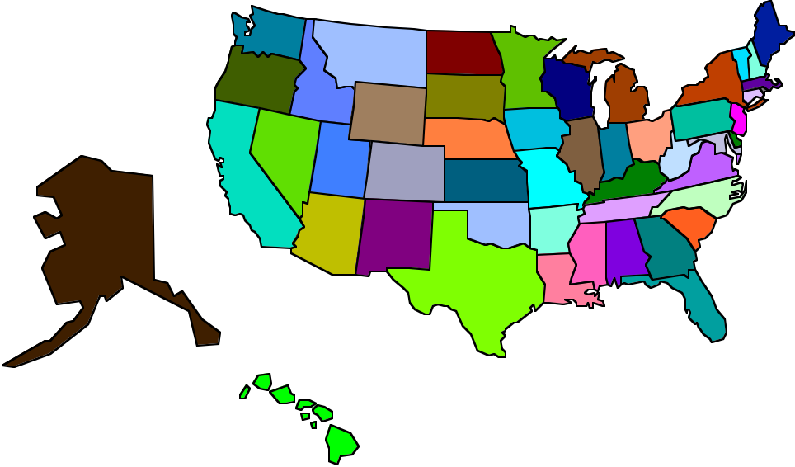
Examples of Node Weights?
Town population
% of certain population by zone
% of electricity use by zone

Slide 15
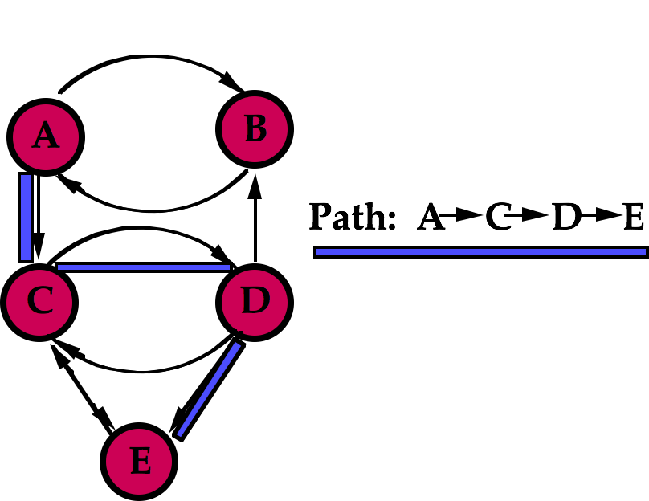

We Can Travel Along PATHS

Slide 16
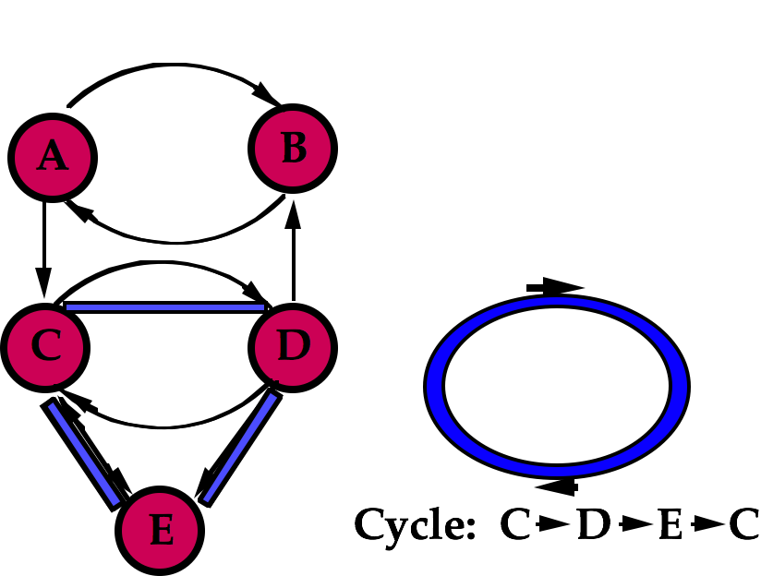

A Special Path is a CYCLE

Slide 17
Some More Examples of Networks

Slide 18
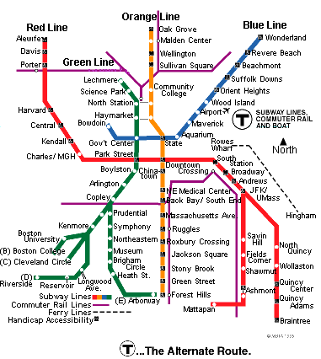
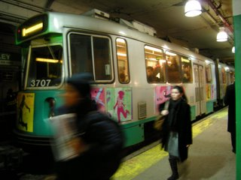
Boston Subway
Notes:
http://3.bp.blogspot.com/_SYIwwsvNixM/R9GZ4nAhy8I/AAAAAAAACnQ/y4QzRekE0KU/s320/Boston+MBTA+subway+train.jpg

Slide 19
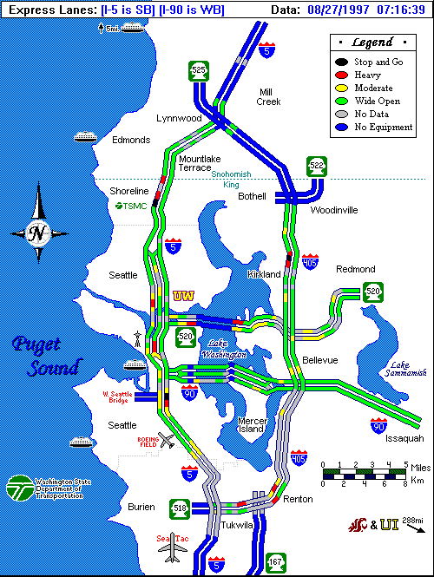

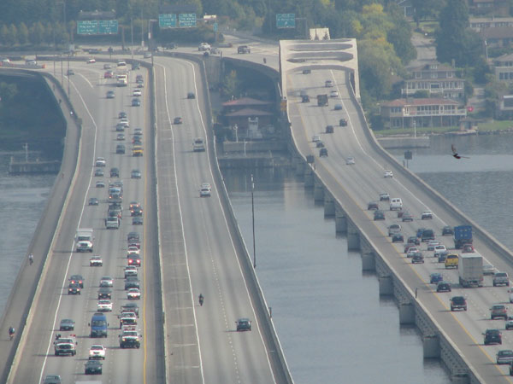
Seattle
Network of
Major Highways
Notes:
http://media.bonnint.net/seattle/2/233/23343.jpg

Slide 20
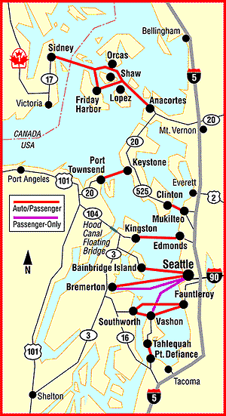
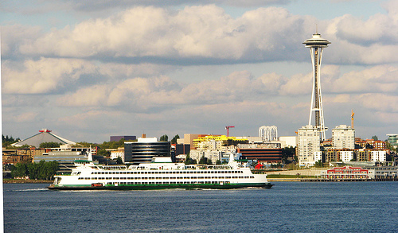
Seattle Ferry Boat Network
Notes:
http://www.northwestliving.net/wp-content/uploads/2007/10/seattle-ferry.jpg

Slide 21
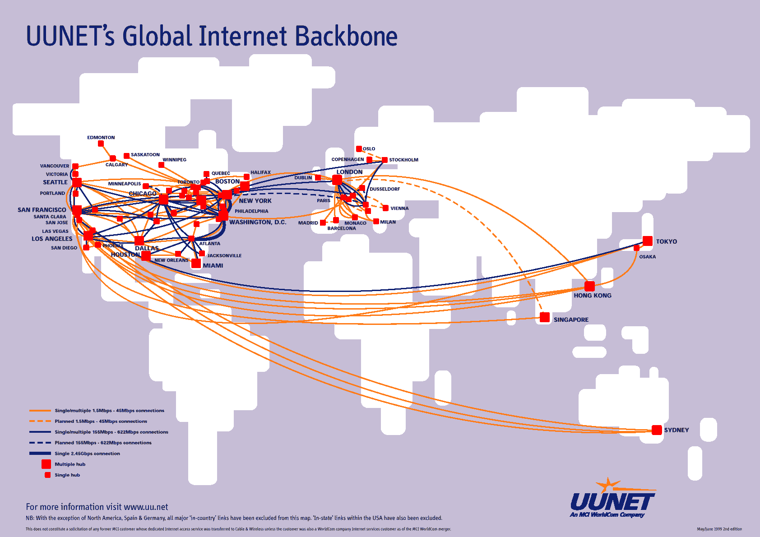
Telecommunications Networks

Slide 22
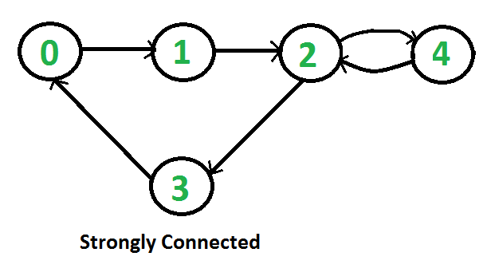
Network Terminology
N = sets of nodes
A = set of arcs
G(N,A)
Incident arc
Adjacent nodes
Adjacent arcs
Path
Degree-ness of a node
In-degree
Out-degree
Cycle or circuit
Connected nodes
Subgraph
Connected undirected graph
Strongly connected directed graph
Notes:
A directed graph is called strongly connected if there is a path from each vertex in the graph to every other vertex. In particular, this means paths in each direction; a path from a to b and also a path from b to a.

Slide 23
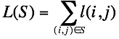
Network Terminology - con't.
Tree of an undirected network is a connected subgraph having no cycles
A tree having t nodes contains (t-1) edges
Spanning tree of G(N,A) is a tree containing all n nodes of N
Length of a path S
d(x,y), d(i,j)

Slide 24

Now to Some Network Decision Problems
Issues of design or deployment on a network

Slide 25

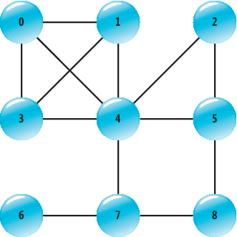
Routing Problems
Shortest path problem
Traveling salesman problem
Chinese postman problem

Slide 26

Shortest Path Problem
Find the shortest path between two nodes, starting at Node O and ending at Node D.
O: Origin node
D: Destination node

Slide 27
Node Labeling Algorithm: Dijkstra
Shortest path from a node
k=1, start at origin node
At the end of iteration k, the set of k CLOSED NODES consists of the k closest nodes to the origin.
Each OPEN NODE adjacent to one or more closed nodes has our current 'best guess' of the minimal distance to that node.

Slide 28
Dijkstra Algorithm, Con't
Each best guess represents a feasible perhaps optimal path
Next step: Close the closest of the BEST GUESSES.
Loop on updating best guesses.
Repeat by replacing k with k+1.

Slide 29
(1,0)
5
3
O
3
1
4
8
2
2
5
4
6
10
D
(k,d)=(iteration k, min distance to node O)

Slide 30
(1,0)
5
(5)
3
O
3
1
4
8
2
2
5
4
(2)
(8)
6
10
D
(k,d)=(iteration k, min distance to node O)

Slide 31
(1,0)
(1,0)
5
(5)
5
3
O
3
O
3
3
1
1
4
4
2
2
2
8
2
8
5
5
4
4
(2,2)
(8)
D
6
D
6
10
10
(k,d)=(iteration k, min distance to node O)
(k,d)=(iteration k, min distance to node O)

Slide 32
(1,0)
(1,0)
(1,0)
5
(4)
5
5
3
3
O
3
O
O
3
3
3
1
1
1
4
4
4
2
2
2
2
2
8
2
(6)
8
8
5
5
5
4
4
4
(2,2)
(12)
(8)
D
D
6
D
6
6
10
10
10
(k,d)=(iteration k, min distance to node O)
(k,d)=(iteration k, min distance to node O)
(k,d)=(iteration k, min distance to node O)

Slide 33
(1,0)
(1,0)
(1,0)
(1,0)
5
(3,4)
5
5
5
3
3
3
O
3
O
O
O
3
3
3
3
1
1
1
1
4
4
4
4
2
2
2
2
2
2
2
8
2
(6)
8
8
8
5
5
5
5
4
4
4
4
(2,2)
(12)
(8)
D
D
D
6
D
6
6
6
10
10
10
10
(k,d)=(iteration k, min distance to node O)
(k,d)=(iteration k, min distance to node O)
(k,d)=(iteration k, min distance to node O)
(k,d)=(iteration k, min distance to node O)

Slide 34
(1,0)
(1,0)
(1,0)
(1,0)
(1,0)
5
(3,4)
(7)
5
5
5
5
3
3
3
3
O
3
O
O
O
O
3
3
3
3
3
1
1
1
1
1
4
4
4
4
4
2
2
2
2
2
2
2
2
2
8
2
(6)
8
8
8
8
5
5
5
5
5
4
4
4
4
4
(2,2)
(12)
(8)
D
D
D
D
6
D
6
6
6
6
10
10
10
10
10
(k,d)=(iteration k, min distance to node O)
(k,d)=(iteration k, min distance to node O)
(k,d)=(iteration k, min distance to node O)
(k,d)=(iteration k, min distance to node O)
(k,d)=(iteration k, min distance to node O)

Slide 35
(1,0)
(1,0)
(1,0)
(1,0)
(1,0)
5
(3,4)
(7)
5
5
5
5
3
3
3
3
O
3
O
O
O
O
3
3
3
3
3
1
1
1
1
1
4
4
4
4
4
2
2
2
2
2
2
(4,6)
2
2
2
8
2
8
8
8
8
5
5
5
5
5
4
4
4
4
4
(2,2)
(12)
(8)
D
D
D
D
6
D
6
6
6
6
10
10
10
10
10
(k,d)=(iteration k, min distance to node O)
(k,d)=(iteration k, min distance to node O)
(k,d)=(iteration k, min distance to node O)
(k,d)=(iteration k, min distance to node O)
(k,d)=(iteration k, min distance to node O)

Slide 36
(1,0)
(1,0)
(1,0)
(1,0)
(1,0)
5
(3,4)
(7)
5
5
5
5
3
3
3
3
O
3
O
O
O
O
3
3
3
3
3
1
1
1
1
1
4
4
4
4
4
2
2
2
2
2
2
(4,6)
2
2
2
8
2
8
8
8
8
5
5
5
5
5
4
4
4
4
4
(2,2)
(11)
(8)
D
D
D
D
6
D
6
6
6
6
10
10
10
10
10
(k,d)=(iteration k, min distance to node O)
(k,d)=(iteration k, min distance to node O)
(k,d)=(iteration k, min distance to node O)
(k,d)=(iteration k, min distance to node O)
(k,d)=(iteration k, min distance to node O)

Slide 37
(1,0)
(1,0)
(1,0)
(1,0)
(1,0)
5
(3,4)
(5,7)
5
5
5
5
3
3
3
3
O
3
O
O
O
O
3
3
3
3
3
1
1
1
1
1
4
4
4
4
4
2
2
2
2
2
2
(4,6)
2
2
2
8
2
8
8
8
8
5
5
5
5
5
4
4
4
4
4
(2,2)
(11)
(8)
D
D
D
D
6
D
6
6
6
6
10
10
10
10
10
(k,d)=(iteration k, min distance to node O)
(k,d)=(iteration k, min distance to node O)
(k,d)=(iteration k, min distance to node O)
(k,d)=(iteration k, min distance to node O)
(k,d)=(iteration k, min distance to node O)

Slide 38
(1,0)
(1,0)
(1,0)
(1,0)
(1,0)
5
(3,4)
(5,7)
5
5
5
5
3
3
3
3
O
3
O
O
O
O
3
3
3
3
3
1
1
1
1
1
4
4
4
4
4
2
2
2
2
2
2
(4,6)
2
2
2
8
2
8
8
8
8
5
5
5
5
5
4
4
4
4
4
(2,2)
(11)
(6,8)
D
D
D
D
6
D
6
6
6
6
10
10
10
10
10
(k,d)=(iteration k, min distance to node O)
(k,d)=(iteration k, min distance to node O)
(k,d)=(iteration k, min distance to node O)
(k,d)=(iteration k, min distance to node O)
(k,d)=(iteration k, min distance to node O)

Slide 39
(1,0)
(1,0)
(1,0)
(1,0)
(1,0)
5
(3,4)
(5,7)
5
5
5
5
3
3
3
3
O
3
O
O
O
O
3
3
3
3
3
1
1
1
1
1
4
4
4
4
4
2
2
2
2
2
2
(4,6)
2
2
2
8
2
8
8
8
8
5
5
5
5
5
4
4
4
4
4
DONE!
(2,2)
(7,11)
(6,8)
D
D
D
D
6
D
6
6
6
6
10
10
10
10
10
(k,d)=(iteration k, min distance to node O)
(k,d)=(iteration k, min distance to node O)
(k,d)=(iteration k, min distance to node O)
(k,d)=(iteration k, min distance to node O)
(k,d)=(iteration k, min distance to node O)

Slide 40
It’s a Tie!
(1,0)
(1,0)
(1,0)
(1,0)
(1,0)
5
(3,4)
(5,7)
5
5
5
5
3
3
3
3
O
3
O
O
O
O
3
3
3
3
3
1
1
1
1
1
4
4
4
4
4
2
2
2
2
2
2
(4,6)
2
2
2
8
2
8
8
8
8
5
5
5
5
5
4
4
4
4
4
(2,2)
(7,11)
(6,8)
D
D
D
D
6
D
6
6
6
6
10
10
10
10
10
(k,d)=(iteration k, min distance to node O)
(k,d)=(iteration k, min distance to node O)
(k,d)=(iteration k, min distance to node O)
(k,d)=(iteration k, min distance to node O)
(k,d)=(iteration k, min distance to node O)

Slide 41
Computational Complexity Network with n nodes
Each iteration: up to n checks
Up to n iterations
Implies O(n²) complexity
For the entire graph: O(n³) complexity

Slide 42
Minimum Manhattan Distance Paths in the Presence of Barriers
Larson, Li, Networks

Slide 43
One of n_{Q} O-D points
One of n_{B}
polygonal barriers

Slide 44
One of n_{Q} O-D points
One of n_{B}
polygonal barriers

Slide 45
Communication: The name of the game!
Two points having coordinates (x, y) and (u, v) COMMUNICATE if there exists at least one feasible staircase path between them.
Such a staircase path has minimum possible Manhattan length:
For example, any 2 adjacent vertices of a barrier communicate

Slide 46
Vertex Seeking Tree
This tree is from a O-D point

Slide 47
Vertex Seeking Tree
This tree is from a barrier vertex

Slide 48
Vertex Seeking Tree
This tree is from a barrier vertex

Slide 49
Vertex Seeking Tree
This tree is from a barrier vertex

Slide 50
Vertex Seeking Tree
This tree is from a barrier vertex

Slide 51
Vertex Seeking Tree
This tree is from a barrier vertex

Slide 52
2 Nodes Communicating Simply if
They are adjacent vertices of a barrier
One is the root and the other is a terminal node of a vertex-seeking tree
If they they have x and y probes that share at least one common non-nodal point b.

Slide 53
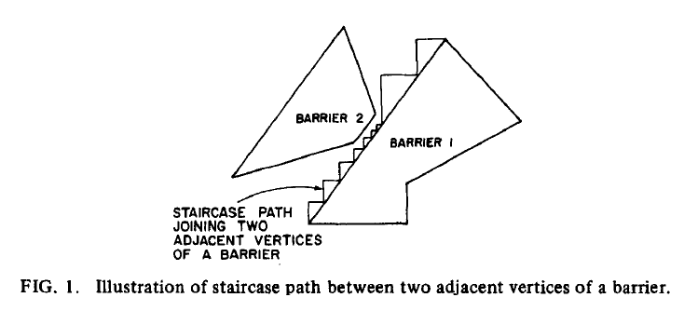

Slide 54
Theorem 1
Suppose 2 points communicate but not simply. Then there exists at least one feasible staircase path between them containing a sequence of simply communicating nodes.
Use 'path push and amalgamation' for proof.

Slide 55
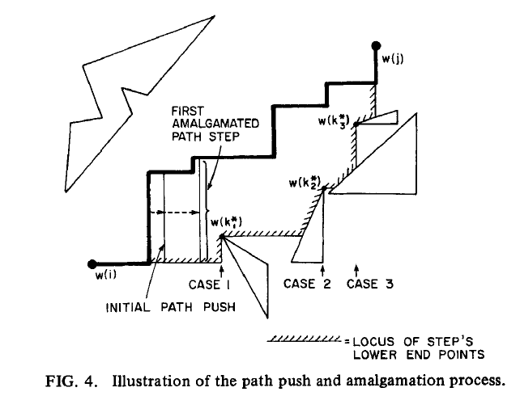

Slide 56
Theorem 2
Suppose 2 points do not communicate. Then there exists at least one minimal distance path between them containing a sequence of simply communicating vertices.
All this implies that we have reduced the problem to a finite network problem and can use Dijkstra, etc. for analysis.

Slide 57
Median Facility Locations with Barriers and Manhattan Metric

Slide 58
Median Facility Locations with Barriers and Manhattan Metric
1/5
1/5
1/5
1/5
1/5

Slide 59
Median Facility Locations with Barriers and Manhattan Metric
1/5
1/5
1-median
1/5
1/5
1/5

Slide 60
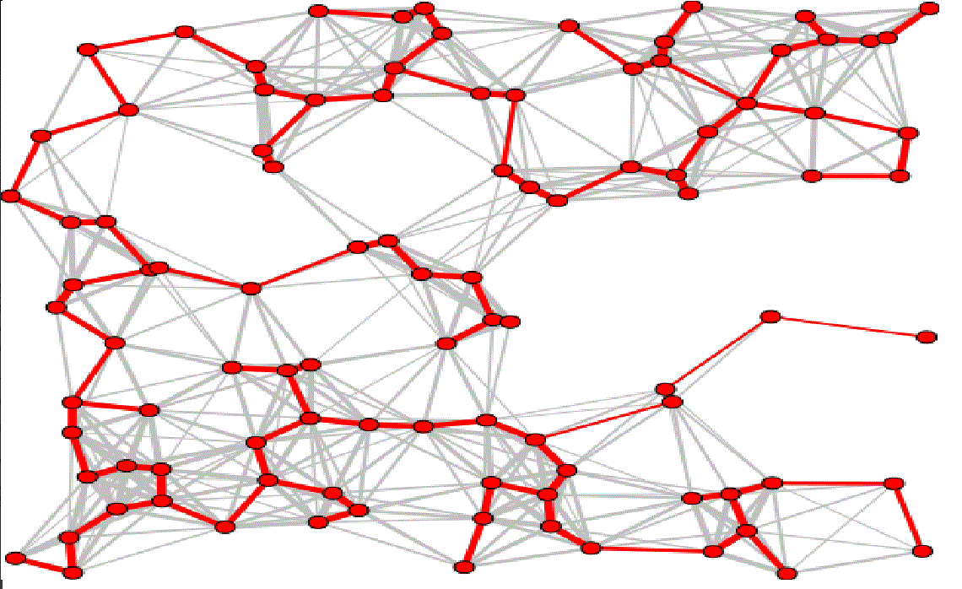
Minimum Spanning Tree (MST) Problem

Slide 61
Minimum Spanning Tree (MST) Problem
Assume an undirected graph
Problem: Find a shortest length spanning tree of G(N, A).
If |N|=n, then each spanning tree contains (n-1) links.
MST may not be unique
Why is this an important problem?
Network design. – telephone, electrical, hydraulic, TV cable, computer, road

Slide 62
MST on G(N,A)
Suppose in the process of (correctly) creating a MST we have created two or more 'sub-trees' covering the set of nodes N, with each sub-tree eventually being part of the final MST. (Note: a single node is a sub-tree!)
Say link (i*,j*) is the shortest link 'dangling' from a given sub-tree. By 'dangling' we mean that node i* is in the given sub-tree and node j* is not. Node j* is part of another sub-tree.
Then link (i*,j*) is part of the final MST.

Slide 63
Proof by contradiction
"Dangling'
link
T₁

Slide 64
Proof by contradiction
T₃
T₂
T₁
MST = T₁ + T₂ + T₃+(one connecting link)+more

Slide 65
Proof by contradiction
T₃
6
7
9
5
11
T₂
T₁
MST = T₁ + T₂ + T₃+(one connecting link)+more

Slide 66
Proof by contradiction
T₃
5
T₂
T₁
MST = T₁ + T₂ + T₃+(shortest connecting link)+more

Slide 67
Corollary
In an undirected network G, the link of shortest length out of any node is part of the MST.

Slide 68
One MST Algorithm
Algorithm: Start at an arbitrary node. Keep connecting to the growing sub-tree the closest unattached node.

Slide 69
Computational Complexity of the MST
Assume a fully connected G
Iteration #1: (n-1) comparisons to find minimum. Label each node with distance to start node.

Slide 70
Computational Complexity of the MST
Iteration #2:
Find distances from newly added node to each node not in the tree & replace labels where necessary. Requires (n-2) comparisons
Find the minimum of the labels. Requires an additional (n-2) comparisons.

Slide 71
Computational Complexity of the MST
Iteration #j:
Find distances from newly added node to each node not in the tree & replace labels where necessary. Requires (n-j) comparisons
Find the minimum of the labels. Requires an additional (n-j) comparisons.

Slide 72
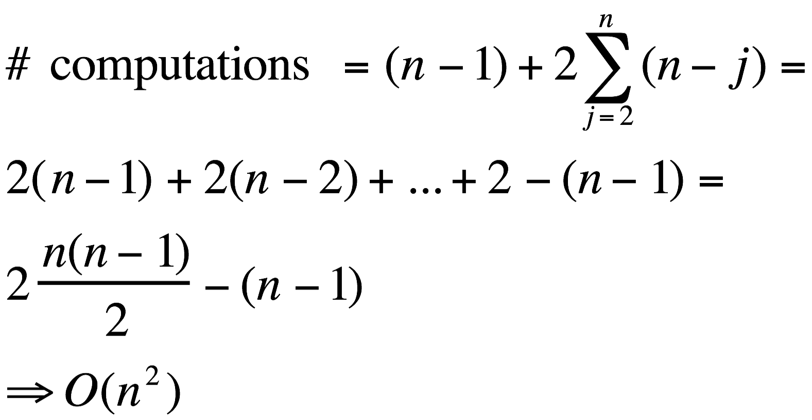

Slide 73
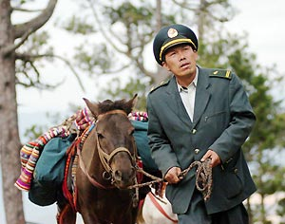
Chinese Postman Problem

Slide 74
Chinese Postman Problem
Find the minimum length tour or cycle that “covers” each link at least once.

Slide 75
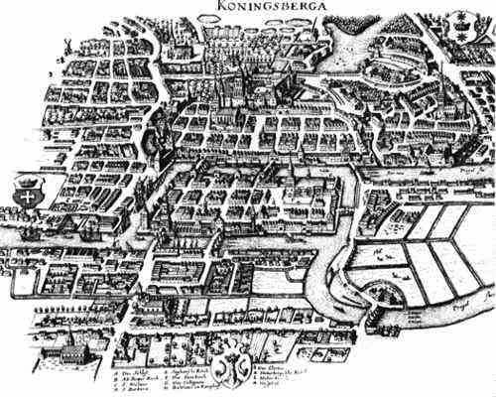
Königsberg bridges
http://www-gap.dcs.st-and.ac.uk/~history/Miscellaneous/Konigsberg.html

Slide 76
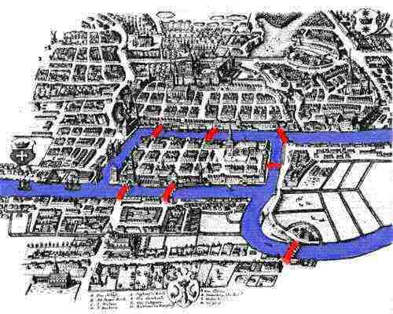
Königsberg bridges
http://www-gap.dcs.st-and.ac.uk/~history/Miscellaneous/Konigsberg.html

Slide 77
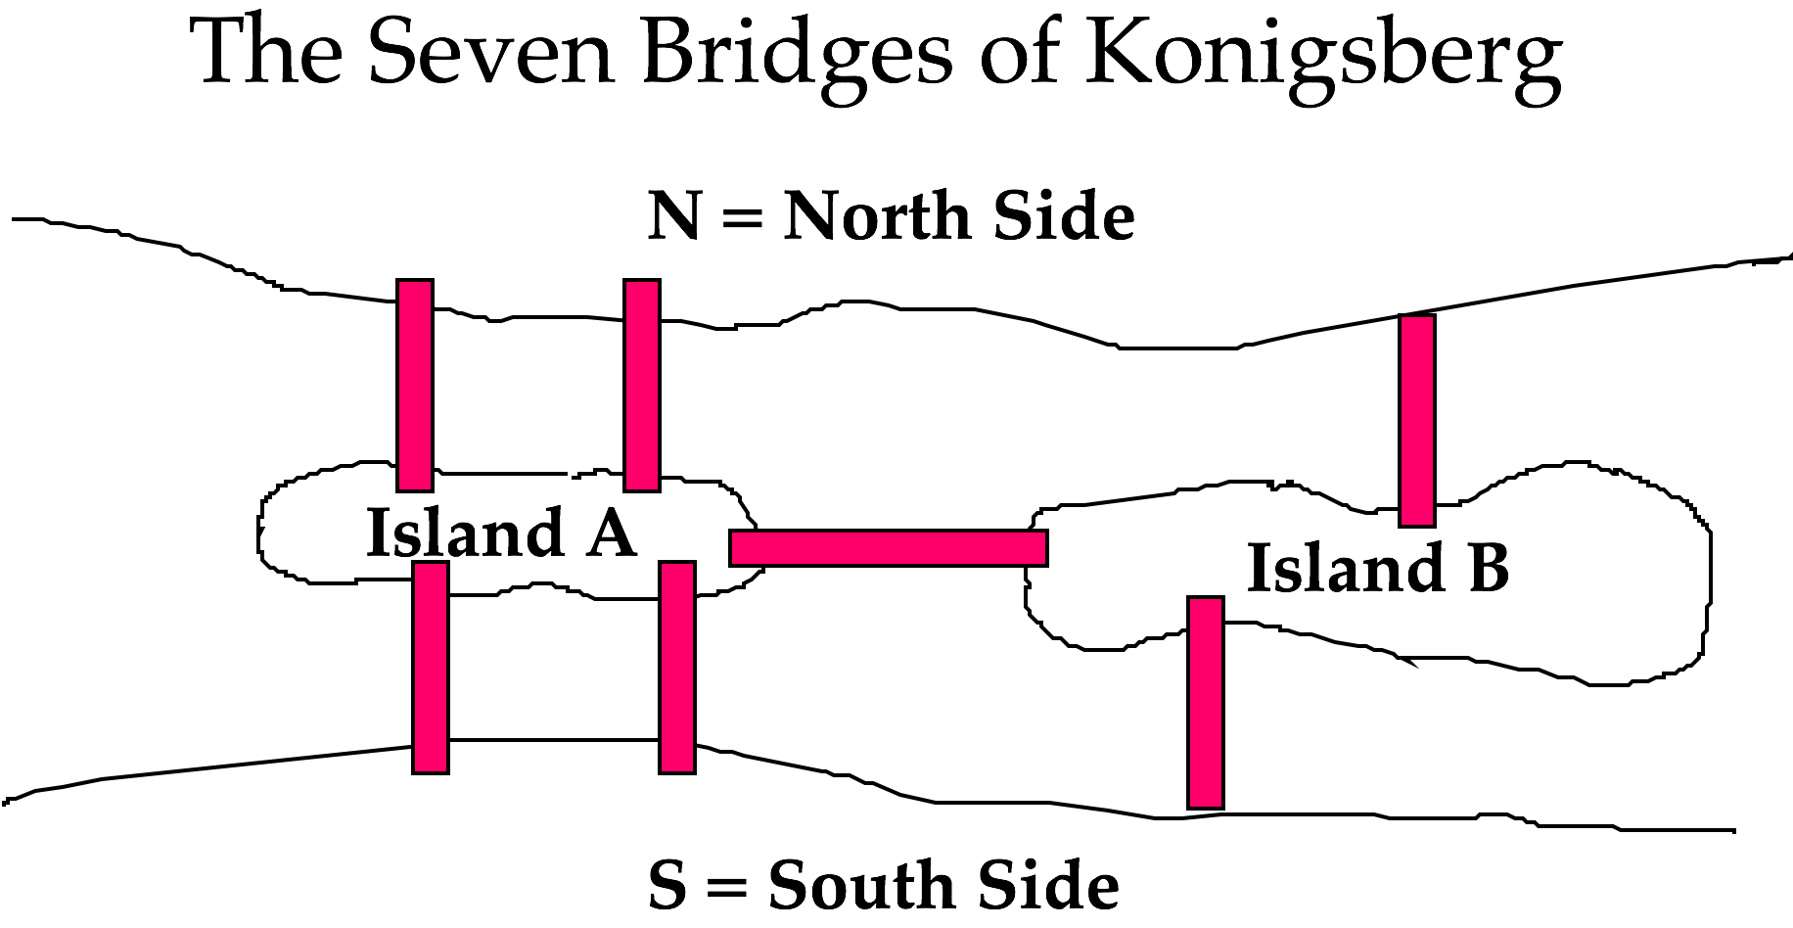
A Famous Problem Leonhard Euler (1707-1783), paper in 1736

Slide 78
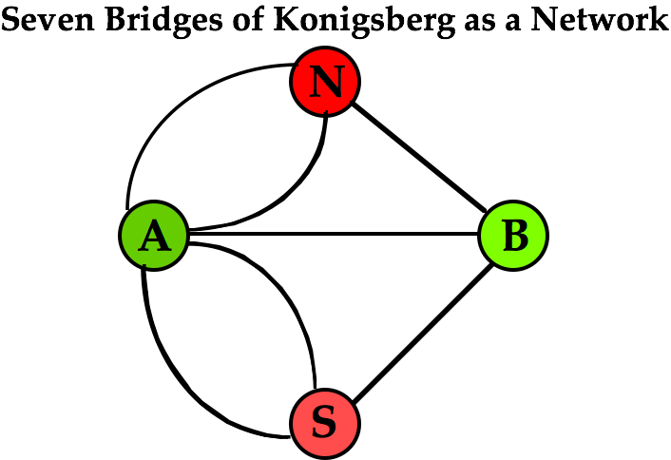
Reduced to a Network

Slide 79
Taking Walks, Delivering Mail

Slide 80
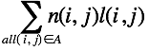
Chinese Postman's Problem on an Undirected Graph
Problem:
Find a circuit that will traverse every edge of G(N,A)
at least once and for which this sum is minimum:
where n(i,j) is the number of times edge (i,j) is traversed.
Definitions: (1) An Euler tour is a circuit that traverses
every edge on a graph exactly once, beginning and
ending on the same node.
(2) An Euler path is a path that traverses every edge
on a graph exactly once.

Slide 81

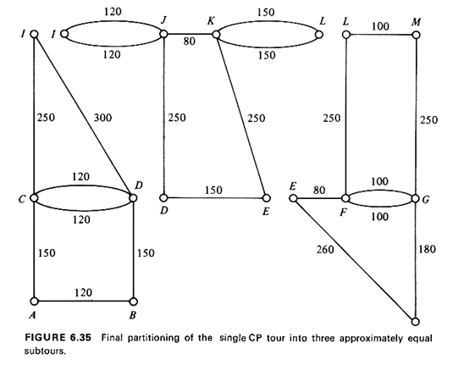
Kwan Mei-Ko, Graphic Programming Using Odd or Even Points, Chinese Math., 1:273-277, 1962.
Alan J. Goldman suggested the name "Chinese Postman problem" to Jack Edmonds when Edmonds was in Goldman's Operations Research group at the U.S. National Bureau of Standards (now NIST). Edmonds appreciated its "catchiness" and adopted it. http://xlinux.nist.gov/dads//HTML/chinesePostman.html
Notes:
http://www.cardmine.co.uk/list25/a250233.jpg
http://web.mit.edu/urban_or_book/www/book/chapter6/images6/fig6.35.gif

Slide 82
Euler's Theorem:
A connected graph G possesses an
Euler tour (Euler path) if and only if
G contains exactly zero (two)
nodes of odd degree.
Constructive proof in book.

Slide 83
Chinese Postman Algorithm:
Identify all m nodes of odd degree in G(N,A). Here m is an even number: Why?
Find a minimum length pairwise matching of the m odd-degree nodes and identify the corresponding m/2 connecting shortest paths
Augment the original graph G(N,A) with 'duplicate' edges from the m/2 connecting shortest paths. Call the new augmented graph G'(N,A').
An optimal solution is an Euler tour on G'(N,A'), which you now find easily!

Slide 84
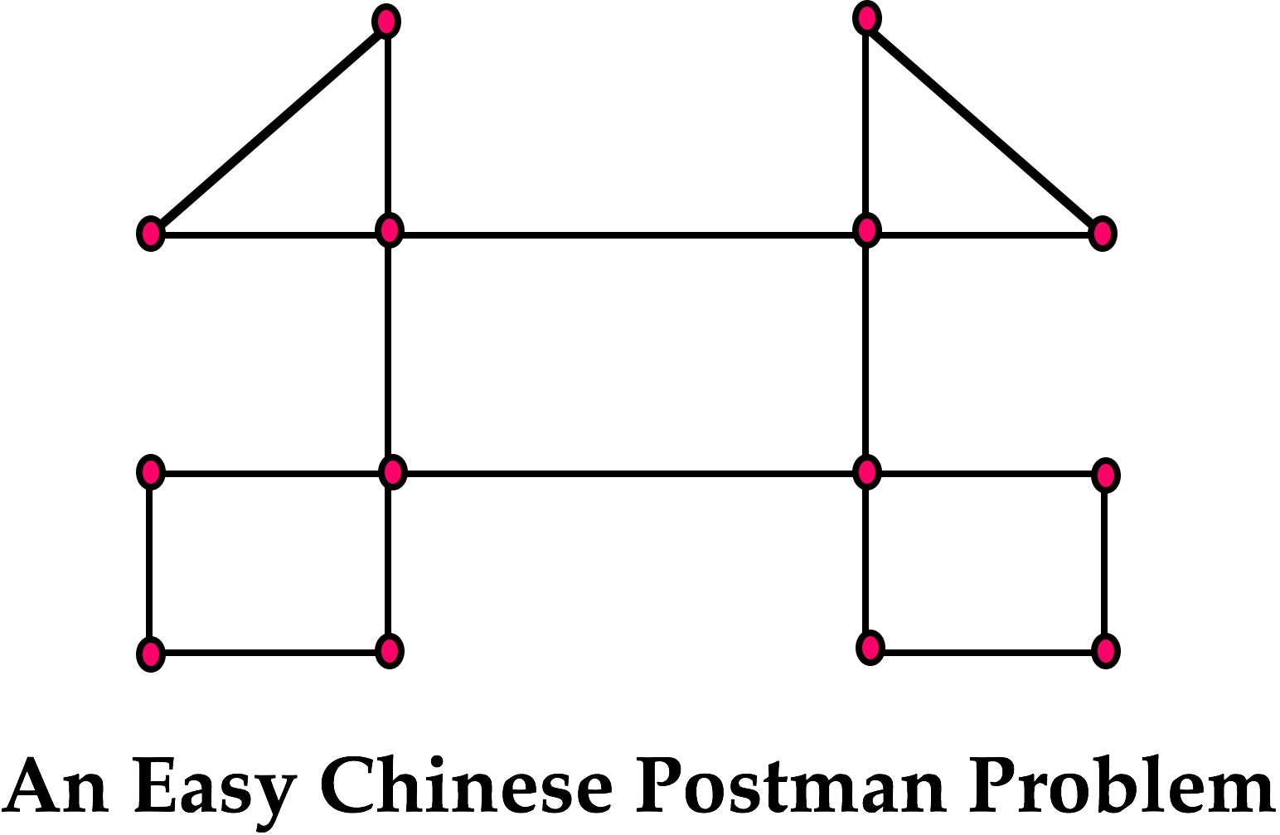
Chinese Postman: Easy

Slide 85
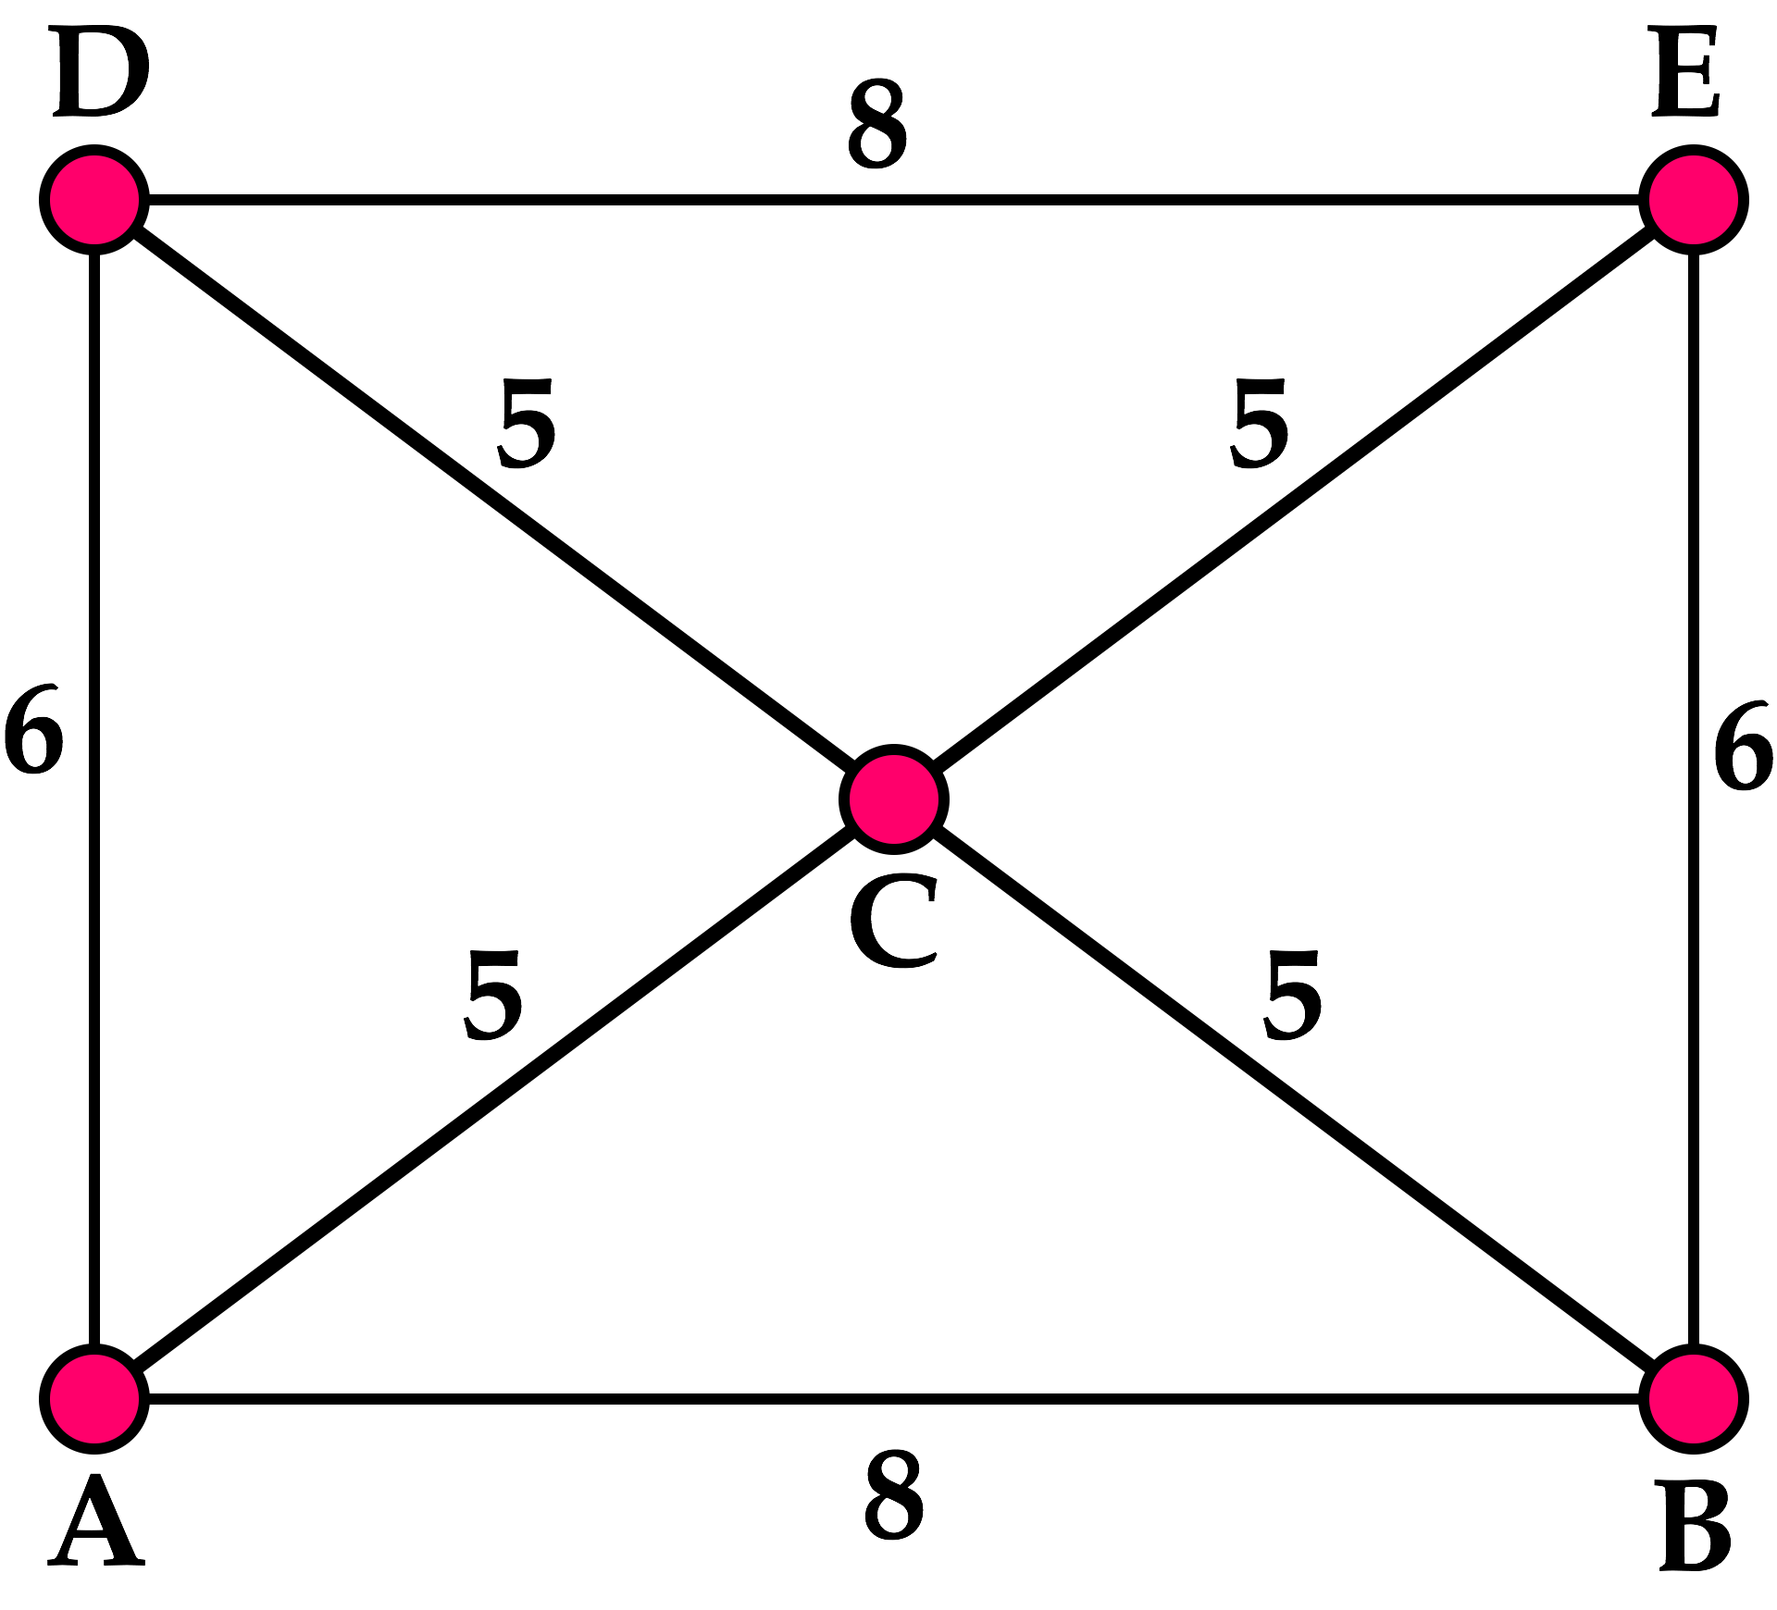
Chinese Postman: Matching

Slide 86
Match #1

Slide 87
Match #2

Slide 88
Minimize
[n(i, j) is the no. of times (i, j) is “covered”]
120
J
80
K
150
L
100
I
M
250
250
280
250
250
300
80
100
C
G
120
D
150
E
F
150
260
180
150
120
A
B
H

Slide 89
3,140 units of total length; 8 odd-degree nodes; 105 possible pair-wise matching combinations
120
J
80
K
150
L
100
I
*
M
*
*
*
250
250
280
250
250
300
*
80
*
100
*
C
G
*
D
E
F
120
150
150
260
180
150
120
A
B
H

Slide 90
Optimal pair-wise matching can be found by inspection; 490 dummy edge units (double-covered); optimal CPP tour has length of 3,830 units
120
J
80
K
150
L
100
I
M
250
250
280
250
250
300
120
80
100
C
G
D
150
E
F
150
260
180
150
120
A
B
H

Slide 91
Solving Manually on a Graph
Given a good “map”, it is possible to solve manually, to near-optimality, large CPPs on planar graphs.
KEY OBSERVATION: In a minimum-cost, pair-wise matching of the odd degree nodes, no two shortest paths in the matching can have any edges in common.
IMPLICATIONS:
Eliminate large no. of potential matches
Search only in “neighborhood” of each odd-degree node

Slide 92
Solving Manually (2)
G
A
C
E
F
B
D

Slide 93
Related CPP Problems
CPP on directed graphs can also be solved efficiently (in polynomial time) [Problem 6.6 in L+O]
CPP on a mixed graph is a “hard” problem [Papadimitriou, 1976]
Many variations and applications:
Snow plowing
Street sweeping
Mail delivery => “multi-postmen”
CPP with time windows
Rural CPP

Slide 94
Traveling Salesman Problem
Find the shortest cycle starting and ending at node O and visiting each specified node A, B, C, etc. at least once.

Slide 95
The Traveling Salesman Problem
Huge literature, endless applications
Job shop scheduling
Vehicle routing problem (VRP)
Dial-a-ride problem (DARP)
Electronics industry
On-line grocery stores
Air traffic control
Genome sequencing
Space applications

Slide 96
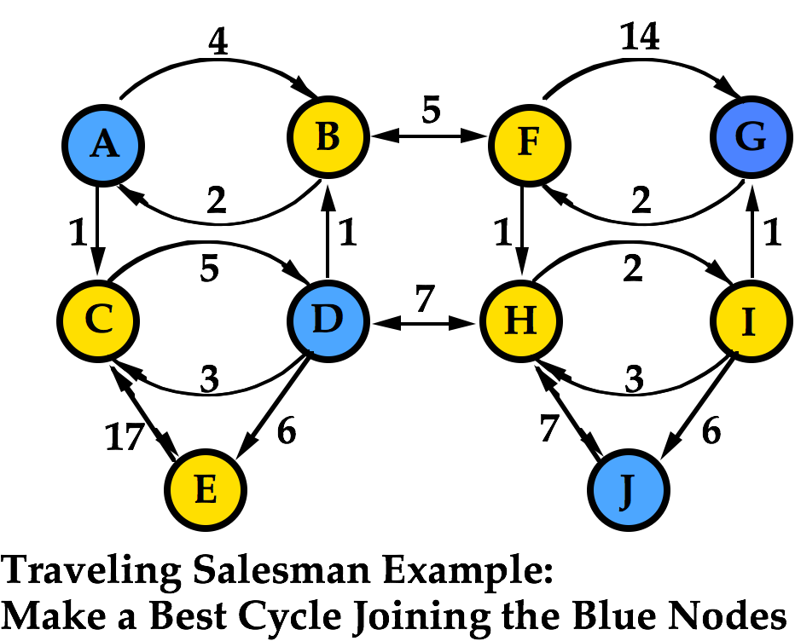

Slide 97
TSP: Traveling Salesman Problem
In this subject we will not emphasize exact algorithms to solve the TSP.
Rather we will discuss a 'simple square root law' result based on a 'probabilistic' interpretation of the TSP that gives remarkably good solutions in many applications.

Slide 98
The Convex Hull Heuristic: Euclidean Plane
8
3
9
1
2
7
10
5
4
6

Slide 99
Adding New Points
8
3
9
1
2
7
10
5
4
6

Slide 100
Convex Hull Heuristic (Euclidean TSP)
Optimal TSP tour cannot intersect itself
Therefore, points on the convex hull must appear in same order on optimal TSP tour
Provides good starting point; for instance, improves insertion heuristics by 2-3%, on average

Slide 101
The TSP with Many Points: A Probabilistic View
We wish to understand how E[L(TSP)], the expected length of an optimal TSP tour behaves as the number of points to be visited, n, becomes large.

Slide 102
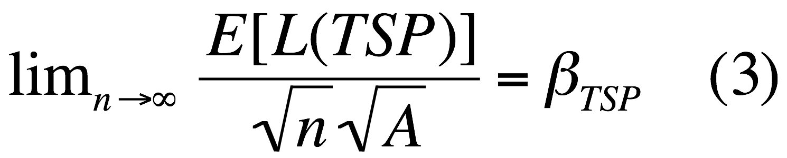
The “Asymptotic Constant”
(Beardwood et al, 1959, and others):
where β_{TSP} is a constant, characteristic of the TSP in the Euclidean plane.
Actually, there is a stronger result: Take out the E[ ], and almost surely (with probability 1) the ratio holds.

Slide 103
Comments
D. Johnson (1995) shows, through a theoretical argument and experimental results, that:
This is significantly different from the earlier estimates of 0.75 and 0.765 cited in L&O, p.408.
In practice the approximation suggested by (3) works very well, even with a quite small number of points (e.g., 25) or with significant deviations from the assumptions of uniformity and independence.

Slide 104

Each of these problem types has been greatly refined and expanded over the years
Each can be implemented via computer in complex operating environments
The Post office, FEDX, truckers, even bicycled couriers use these techniques

